Slide 1
CVSH Next Best Action (NBA) Decisioning & Customer Interaction Management Capability Strategy v0.1
Ravi Vangala, Senior Director – Caremark Business Architecture, Service Excellence
09/01/2021

Slide 2
Executive Summary

Slide 3

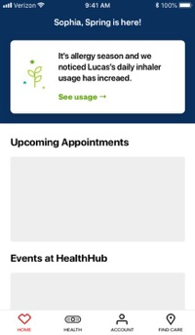
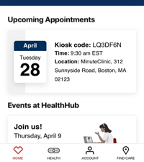



NBA Decisioning & Interaction Management Capability Sample Customer Journey – Current State Illustration with Gaps Identified
DEMOGRAPHICS
42 years old
HEALTH HISTORY
Pre-diabetic, over-weight, kidney condition, all known to CVSH.
Recent stress and depression issues that she hasn’t discussed with anyone yet and hence unknown to CVSH.
INSURANCE STATUS
Aetna and Caremark Commercial member
Enrolled in CVS Health Diabetes Care Management program
GOALS
Lose weight, get healthier, cope with stress
Sophia
1
2
3
4
10:00 AM
2:00 PM
Lack of Care Coordination
2:15 PM
Day +1
1
Lack of Care Coordination
Pharmacist
Aetna Care Manager
Aetna Care Manager
CX
Aetna sends an SMS message reminding Sophia to get a Flu vaccine, with a link to schedule appointment in a CVS Pharmacy
Sophia schedules a visit for 2 PM at a local CVS Pharmacy
Sophia gets her Flu vaccine.
During routine diabetes counselling, Pharmacist recommends her to go for an A1C test.
Sophia informs the Pharmacist about her recent depression symptoms.
Sophia needs assistance with insurance coverage information. Pharmacist warm-transfers the call to an Aetna concierge.
Aetna Care Manager reminds Sophia to get a Flu vaccine
Aetna CM is unaware of Sophia’s Behavioral Health needs and completely misses to advice her.
Aetna Care Manager calls Sophia to discuss her Behavioral Health needs.
4
Follow-up interaction
2
Stale messaging
3
Missed opportunity
Operational cost $$
CX
CX
MCS
$$
Monitization $$

Slide 4






Current Offline NBA Decisioning vs Proposed Real-time Interaction Management (RTIM) Capability
Current offline NBA Decisioning Capability
Offline
Proposed Real-time Interaction Management Capability
Online
Outcome: Agent/Digital engagement channels rely solely on the NBA decisions made by the “offline brain”, with no decisioning assistance during live interactions with customers.
Outcome: A “live brain” monitors customer interactions in real-time, learns from customer propensity and executes NBA decisioning and re-decisioning most relevant to the moment.
5
Interactions
NBA presented based on real-time decisioning
4
Digital engagement
4
NBA Decisioning
3
NBA presented based on offline decisioning
Online
Real-time NBA decisioning
Live context, propensity
Patient / Member
Virtual Care
SMS
Email
Chat
Patient / Member
Customers and colleagues mostly interact during the day
Web
Mobile
Sensory system
1
1
Agent engagement
Continuous decisioning
Continuous learning
Transactions
Brain works during the night
Transactions
Brain works day & night, assisting live interactions
Real-time journey orchestration
Offline NBA Decisioning
Pharmacist
Minute
Clinic NP
Care Manager
Care Concierge
CSR
NBA Decisioning
Claims
EMR
Rx
Offline
Claims
EMR
Rx
2
3
2
Customer Profile
Left Brain
(Rules Engine)
Right Brain
(AI / ML)
Customer Profile
Left Brain
(Rules Engine)
Right Brain
(AI / ML)
Why RTIM?
Customer experience: The ideal customer experience would be to utilize the newly learnt information about the customer’s interests and propensity to make insights-driven NBA decisioning during a live interaction, rather than defer and re-engage the customer the following day.
Monetization: Engagement channels encounter significant new information and propensity of the customer during live interactions, that can be utilized for decisioning of monetization opportunities while the customer is actively engaged in the interaction and interested in CVS Health products and services. A delayed action could be a lost opportunity!
Care Coordination: Warm transfers and customer interactions across multiple CVSH providers/colleagues will be assisted by seamless system workflow of actions.
Effectiveness: The most effective time to serve a customer with Next Best Actions is during a live interaction rather than defer to a subsequent interaction!
Cost savings: Avoidance of need for re-engagement results in reduction of outreach calls and thereby cost savings.
Current state gaps:
Today, the NBA Decision engines work only during the night (batch process) whereas customers and colleagues interact mostly during the day. No Decisioning assistance at the moment of influence!!. Live context and customer propensity NOT utilized in the NBA Decisioning.
Multiple NBA Decision engines are working in silos, resulting in duplicate and conflicting messaging.
Fragmented customer journey orchestration due to multiple interaction management engines.

Slide 5

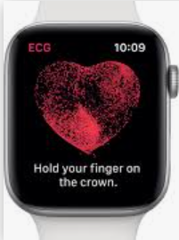

NBA Decisioning & Real-time Interaction Management Capability Architecture
RTIM
Patient / Member
Patient / Member
Interactions
Transactions
Digital interactions
Agent interactions
Browsing
Transactions
IoT
Multiple interaction channels
SMS
Email
Chat
IoT
Web
Mobile
Virtual Care
Pharmacist
Minute
Clinic NP
Care Manager
Care Concierge
CSR
Click streams
Propensity
Rx
EMR
Claims
1b
Real-time Information
Continuous decisioning
Decision request (w/context)
NBA Decision (milli seconds)
Customer Response
Continuous learning
Event stream
Continuous learning
Customer Decision Hub Real-time Journey Orchestration
Enterprise Customer Data Platform
Marketing NBAs
(Example: monetization opportunities)
Interests
Profile
Four different NBA domains
Clinical NBAs
(Example: Gaps-in-Care clinical interventions as part of Care Management programs with measurable KPIs)
Motivation
Context
Medical Cost Savings NBAs
(Examples: Readmission avoidance, Brand-to-Generic Rx)
Intent
History
1a
Operational NBAs
(Examples: Call Center Call Deflection, Rx refill reminders, 30-to-90-day Rx conversions)
Static Information
Other
Environment
2a
Left Brain Decisions
(rules engine)
Right Brain Decisions
(ML/AI)
2b
Interaction History
Real-time learning of customer State, Decision and Response data
Interaction
recording
Aggregations
(Action, Channel, Response)
Augmented Intelligence
Ingest
Continuous stream of aggregates for learning
AI Insights

Slide 6


NBA Decisioning and Interaction Management – Current State vs Proposed (end state)
Roadmap pending
Current state
Proposed
Fragmented customer experience
NBA Decisioning
Interaction Management
NBA Decisioning
Interaction Management
Retail
RxDW-PCI
ROCM
……
……
Retail channels
……
RTIM
……
Retail channels
……
PSS
HEE
……
NBA Decisioning
Interaction Management
……
……
PBM channels
……
……
……
PBM channels
……
……
……
HCB channels
Care Engine/
Health Engine,
A&BC
CPL
……
CEE
HCB, Enterprise
HPD/QME
……
……
HCB channels
BENZ
……
Other
QME

Slide 7
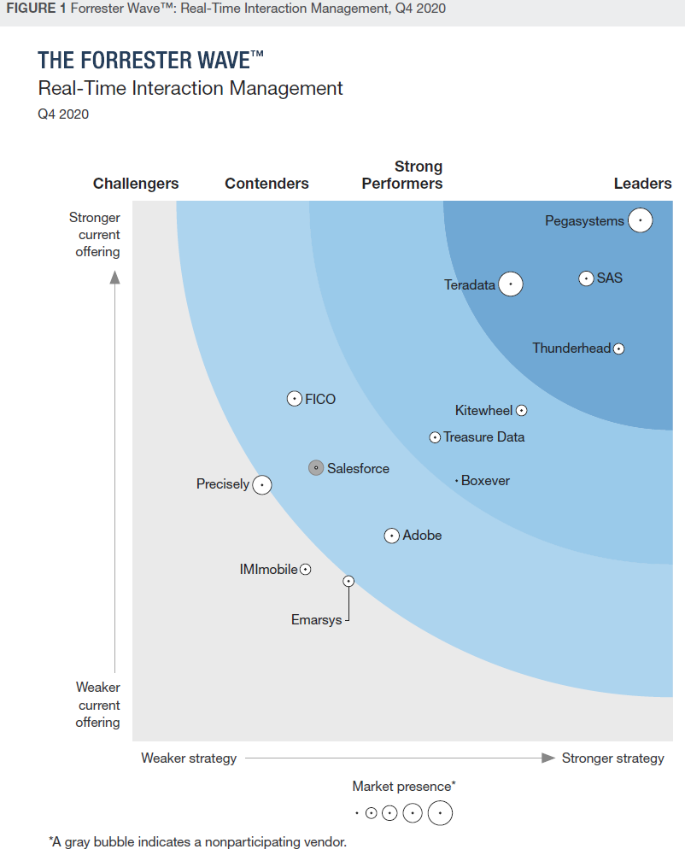
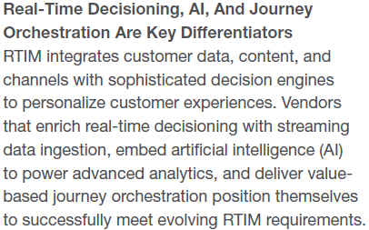
Real-time Interaction Management Forrester Wave

Slide 8
NBA Decisioning and Interaction Management: Capability-Investment Alignment
Desired outcome: Ensure no duplication and conflicting NBA messaging across Clinical, Marketing and other domains.
Note: NBAs are multi faceted. An A1C GiC NBA is a “Clinical” opportunity for the member/patient and a monetization opportunity for MinuteClinic.
Observation: Multiple siloed investments that can be rationalized.
# | Capability L1 | Capability L2 | * Health Engine | * MarTech | C360 | BENZ | Other
1 | NBA Decisioning | The Left Brain (Rules-based decisioning) | x | x
2 |  | The Right Brain (AI/ML decisioning) | x | x
3 |  | Decisioning based on static data (Claims, Rx, Profile etc.) | x | x
4 |  | Decisioning & re-decisioning based on Real-time context and propensity |  | x
5 | Interaction Management | Campaign Management | x | x
6 |  | Journey orchestration of offline NBAs | x | x
7 |  | Journey orchestration of Real-time NBAs |  | x

Slide 9
Appendix

Slide 10
CVSHealth Current State Next Best Action(NBA) Framework
Capability:
New:
Modified:
Existing:
Future:
Transit:
Integration:
1
2
3
4
5
Data
sourcing
Enterprise coordination
Enterprise NBA targeting, aggregation & coordination:
Enterprise NBAs are generated by Health Engine/ A&BC as batch processes in support of enterprise programs (e.g. ngTDC).
Aggregated, prioritized and coordinated centrally by CPL for delivery across LOBs.
Dispositions go back to CPL in near real-time and enable CPL to cancel/pull-back from other channels and to generate re-targeted NBAs offline (batch process).
Domain NBA targeting and aggregation:
Domain targeted NBAs that are suitable for domain-only delivery will be aggregated and reconciled with the enterprise NBAs.
E.g. Rx fill counselling opportunities that need to be delivered by RPh.
Cross-domain supporting opportunities will be sent to CPL for distribution across domains. E.g. “A reminder to talk to RPh about your Rx” that can be delivered across CVSH in support of a domain opportunity at Pharmacy.
Domain arbitration enriches enterprise NBA data, by augmenting with domain data and logic.
E.g. Selection of appropriate store based on patient Rx activity, trigger scripts etc.
E.g. Aggregation of opportunity message content from multiple opportunities to fit in to limited real-estate space on the Rx Label.
Disposition sent back to CPL near real-time
Channel orchestration:
Channel orchestration engines maintain awareness of channel colleague capacity, workload etc., to identify optimal channel for delivery at specific time
Enables team-work among the LOB channels via Next Sequence Actions (NSA) e.g. coordinated workflow as patient moves across stations between MinuteClinic, RPh, Care Concierge etc.
Near real-time NBA recording data made available to C360.
Enterprise NBA targeting
Domain aggregation and Channel orchestration
Channel
delivery
2a
Domain NBA targeting
HCB non-CM channels
CPL
HCB
NBA aggregation
Benz
HCB Digital orchestration
API
Aetna Health
Email/SMS/Fax, IVR
SFMC, GPS
Print, SOP
Marketing mail
CPL
HCB non-CM orchestration
API
API
HCB CM channels
HCB
Targeting (ATV, Medcompass)
CEE
HCB CM orchestration
Med compass
ATV
CEC
Epic-AHM
CVSH data sources
Other enterprise sources
Enterprise Feedback
Opportunities
All Feedback
QME
Retail channels
Enterprise Data Platform (EDP)
Health Engine/ A&BC
Gaps-in-Care, NBA (enterprise programs)
CPL
Enterprise NBA coordination
ROCM
Retail NBA aggregation(PCI, ROCM),
Retail channel orchestration(ROCM)
RxConnect channels
Minute Clinic Epic
HealthHUB CET
POS
RPCC
API
PCC, RPh Panels
CPCO
Inbound IVR
Intrado IVR & SMS
Retail digital
Retail Targeting (RxP, RxDW, HEE)
Instore counsel
DEP
RPh AI
Retail Epic
External data sources
Other enterprise sources
Enterprise Feedback
All Feedback
Opportunities
Rx DW
PBM channels
HEE
PBM NBA aggregation,
PBM channel orchestration
Inbound IVR CC
Caremark. com
Email/SMS/Fax
eClinical
Coram Epic
API
Outbound call center
RxAd call center
Transform care
Specialty call center
Accordant Epic
PBM Targeting
(HEE, CSS)
DEP
ECCM
Polaris
Non-CVS pharmacies
Data publish
PBM DW
Data publish
Data publish
Clinical/Data platform

Slide 11
Summary of Gaps and Opportunities with the existing NBA framework
Lack of cross-LOB business NBA governance: All three LOBs Retail, PBM and HCB have significant shared populations as well as overlapping Care Management programs. However currently there is no cross-LOB governance that would ensure optimal customer experience across enterprise channels, potentially resulting in duplicate and stale messaging to shared populations. Some examples include vaccination campaigns, brand-to-generic drug conversation campaigns etc.
Customer experience: The ideal customer experience would be to utilize the newly learnt information about the customer’s interests and propensity, to make insights-driven NBA decisioning during a live interaction, rather than defer and re-engage the customer the following day. Currently, our customers and colleagues interact mostly during the day whereas our NBA Decisioning engines work during the night, thereby complete absence of live insights-driven NBA Decisioning assistance to the live interactions.
Monetization: Engagement channels encounter significant new information and propensity of the customer during live interactions, that can be utilized for decisioning of monetization opportunities while the customer is actively engaged in the interaction and interested in CVS Health products and services. A delayed action could be a lost opportunity!
Care Coordination: Warm transfers and coordinated customer interactions across multiple CVSH providers/colleagues will need to be assisted by seamless system workflow of insights-driven NBA actions. This is a concrete need today in multiple areas, but the underlying technology capability does not exist.
Effectiveness: The most effective time to serve a customer with Next Best Actions is during a live interaction rather than defer to a subsequent interaction!
Cost savings: Avoidance of need for re-engagement results in reduction of outreach calls and thereby cost savings.
Continued….

Slide 12
What are some of the major gaps with the existing NBA framework?
Data
1. Stale data used as input to NBA insights.
HCB and Enterprise Payor Agnostic Care Management programs NBA targeting mechanism relies very heavily on claims data which could be up to 30-90 days latent, and as a result, significant percentage of NBAs could be stale. A potential mitigation might be to leverage live CDR data, but that is subject to constraints due to the industry regulations that restrict interoperability data use limiting to “clinical treatment” context which allows consumption by MinuteClinic, Retail Pharmacy, Specialty Pharmacy and Coram but not by other LOBs. Typically, Payors are not allowed to use interoperability data due to lack of “clinical treatment” applicability.
PBM programs NBA targeting mechanism is based on PBM DW data which is 24 hours latent. NBAs could be stale by maximum of 24 hours.
Retail NBA targeting mechanism is based on real-time replicated data in RxDW, further, NBAs are re-validated with real-time Rx data right before delivery. No significant staleness expected for Retail domain NBAs (50M a day). However, several Aetna and enterprise NBAs are also sent to Retail Pharmacy for delivery which could be stale, as described in item #1 above.
2. Duplicate delivery of the same NBA (often stale) over and over again, potentially causing customer annoyance besides lack of continued relevance in some situations.
As an example, Aetna sends a Flu vaccine reminder NBA to member John Smith. John goes to CVS/Walgreens to get Flu shot. A few days later John goes to Aetna Health digital app, notices the Flu vaccine reminder NBA popup and declares that he had already taken one. Subsequently John calls Aetna CSR and gets reminded again of Flu vaccine. The CSR records in the system that John already took the Flu vaccine, but that disposition is not immediately used by the insights engine and hence subsequent interactions with other channels such as Care Management also result in Flu vaccine reminder NBA until the next batch of Targeting runs later that night/week.
Tech
Continued….

Slide 13
What are some of the significant gaps with the existing framework?
…Continuation
3. Batch mechanism, no re-decisioning based on real-time context
Results in duplicate NBA delivery across multiple channels until the next batch retargeting process runs, as described on the previous slide.
4. Batch mechanism, no decisioning based on real-time context
A. Results in missed opportunities to help the customer better.
Example #1: CVSH is unaware that John Smith has mental health needs. John happens to be browsing on the MinuteClinic website, clicks on the Behavioral Health(BH) services link and browses through the content. John lacks the motivation to schedule a visit and leaves the website. That is an opportunity for CVSH to learn John’s interest in the BH service, but currently we do not follow-up with an email/SMS NBA. A minute later John happens to be in a conversation with an Aetna CSR on an unrelated matter but there is no NBA that would prompt the CSR to bring up the mental health needs topic to discuss how CVSH can help.
Example #2: John goes to the MinuteClinic website and cancels a previously scheduled visit for a Diabetic Retinopathy Exam(DRE) screening. A minute later John happens to be on a call with a CVSH associate. We do not follow-up with John to encourage him to reschedule the missed visit.
B. Results in missed opportunities for monetization (upsell/cross sell).
Example: While browsing on the HealthHUB website, John is attracted to the newly launched Nutrition service and clicks on the content to learn about it. John lacks motivation to enroll in the program and leaves the website. We do not follow-up with an NBA that could inform John of the promotional offer that is currently running on the Nutrition program. Later that day John calls Aetna CSR to discuss an unrelated matter, but there is no NBA to prompt the CSR to offer the promotion on the Nutrition service.
Tech
Tech
Continued….

Slide 14
What are some of the significant gaps with the existing framework?
…Continuation
5. Complex landscape consisting of multiple technologies involving multiple teams, requiring integration work, and slowing down speed to market.
Each new program launch requires massive projects with multiple technology teams across Analytics and IT to be engaged in integration activities, resulting in slow speed to market.
6. Home-grown technology systems in the commodity market space, limited configurability and robustness.
Targeting, Campaign management and journey orchestration are all easily available as commercial off the shelf products ready for use as well as robust and highly configurable. However, Health Engine, CPL, ROCM, BENZ and CEE are all home-grown applications with significant recent investments.
7. Infrastructure deficiencies
Some of the NBA engines are business-developed and business-maintained applications, with deficiencies in lower environments, some with just a development server besides production server.
8. The brain for clinical and Medical Cost Savings NBAs
The brain consists of two components:
Rules engine: Hundreds of clinical rules exist at a program and condition level coded in Drools rules engine, which is not robust.
ML insights: Individual consumer behavioral insights are executed by the ML models, which is a mature area in CVSH. No gaps are observed in this area.
9. Duplicate NBAs across LOBs, insufficient enterprise aggregation
Example: John Smith is an Aetna member and a CVS Pharmacy patient. Both Aetna and CVS Pharmacy have annual Flu vaccine NBA campaigns within the respective domains. There is no centralized aggregation and de-collisioning of the domain NBAs. As a result, John gets two reminders/outreaches. A potential simple mitigation would be to run mutually exclusive campaigns for the shared population.
10. Pull by channel versus push NBAs into channel
Retail and PBM channels predominantly operate on the “pull” method such that dozens of channels don’t contain local logic but rather call the channel orchestrator in real-time for NBA retrieval. This model works well. However, many of the HCB channels operate such that the channel-orchestrator pushes NBAs into the channels.
Tech
Tech
Tech
Tech
Process
Tech
Tech
Continued….

Slide 15
CVSH Next Best Action Customer Interaction Management Capability Vision
Customer
To improve customer experience by turning data into AI-driven insights and actions and by orchestrating customer interaction journeys with real-time-context relevant Next Best Action(NBA) Decisioning consistently across digital and colleague engagement channels, achieving seamless engaging experience for our customers on their path to better health and medical cost savings, while realizing monetization opportunities for CVS Health.
Better outcomes
Lower cost
Digital interactions
Next Best Action
Agent interactions
Decisions
Data

Slide 16





Sample customer journey coordinated across Digital and Agent channels orchestrated by RTIM (future)
DEMOGRAPHICS
42 years old
HEALTH HISTORY
Pre-diabetic, over-weight, kidney condition, all known to CVSH.
Recent stress and depression issues that she hasn’t discussed with anyone yet and hence unknown to CVSH.
INSURANCE STATUS
Aetna and Caremark Commercial member
Enrolled in CVS Health Diabetes Care Management program
GOALS
Lose weight, get healthier, cope with stress
RTIM outcome: The RTIM “brain” continuously learns about Sophia’s activity, live context, and new information gathered in real-time, and utilizes that information in making new decisioning and re-decisioning of NBAs and orchestrating them across all CVSH engagement channels (including digital, and agent operated) achieving in coordinated and timely Next Best Actions delivery.
Sophia
1
2
3
4
CVSH Diabetes Care Management program sends her an email and push notification reminder with a few options, including a link to a local MinuteClinic to schedule an A1C test.
While scheduling the A1C test appointment on the MinuteClinic site, based on Sophia’s location info, she is guided to the Behavioral Health counselling service that is newly being offered in a local HealthHUB. Sophia clicks on the BH link and reads content. However, she is unsure if her insurance would cover for the service, lacks motivation to schedule a visit and decides to talk to a friend who recently went for a BH counselling at Walmart clinic.
Sophia continues to navigate to other areas of the HealthHUB website and adds a Phillips glucose meter to the shopping cart. However, she is curious about pricing offered by other merchants, and starts shopping around Amazon and other Retail web sites.
A CVS digital push notification is presented to Sophia offering a 10% discount on the CVS branded glucose meter that she is entitled for due to her enrollment status in the Diabetes program. Sophia instantly accepts the offer.
Sophia missed her annual A1C test.
Clinical
alert
Upsell
$$
Upsell
$$
8
7
6
5
A few minutes later Sophia receives a call from the local CVS Pharmacist, offering multi-dose packaging that would make it easier for her to take medications.
The Pharmacist also presents an opportunity to switch from brand to generic drug.
Aetna concierge reminds Sophia of the Flu vaccine and the importance due to spike in ILI activity in her geography. During the conversation Sophia mentions to the Aetna concierge about the multiple medications she is taking for her Kidney condition and some confusion around when to take which medication. The Aetna concierge records the information in the system.
A few minutes later, an Aetna A1A concierge calls Sophia to discuss Behavioral Health service options and her current coverage status with EAP and how MinuteClinic BH service can help with her condition.
Sophia stays on her path to better health and medical cost savings.
MCS
$$
Operational alert
MCS
$$
Clinical
alert

Slide 17
CVSH NBA framework capabilities vs proposed Real-time Interaction Management (RTIM)
CVSH enterprise opportunity/NBA framework (current)
RTIM (proposed)
IoT, digital
……
Health Engine
CPL
ROCM
……
RTIM
……
External data
Retail channels
……
Retail channels
Channel orchestration
External data
Interaction History
Offers & Actions
Predictive & Adaptive models
Next Best Action Strategy Designer
Engagement Policies
Channel Treatments
Event Manager
Business Simulation
NLP
Journey Visualization
1:1 Ops Manager
……
Analytical insights & ML
Campaign management
……
Real-time Channel Orchestration
Web
Mobile
Agent
Digital Ads
Others
……
Architecture
EDP
Decision engine
Channel coordination
HEE
……
……
PBM channels
EDP
……
PBM channels
Channel orchestration
……
Drools
Java
Apache Spark
Python
Java
Spark, Hive
MySql
……
……
Internal data
CEE
……
Internal data
……
HCB channels
……
HCB channels
Channel orchestration
……
……
……
Batch opportunities/NBA
Real-time & batch opportunities/NBA
Batch method only - analytical opportunities are identified offline via a batch process and sent to channels to engage the customer. This can result in a disconnected customer experiences (ex. Gaps in care)
Real-time, batch, & event
Analytical insights and decision-engine run in real-time during customer interaction enabling informed and timely journey orchestration. Event strategies to monitor and make decisions on high velocity data streams (IoT, Wearables, etc.)
Operating method
Real-time decisioning
x
Real-time decisioning (e.g., Pega CDH response times of <150ms)
Real-time Journey orchestration
Pre-identified analytical opportunity delivery in real-time/batch. Latency in opportunity identification and delivery.
Real-time decisioning and re-decisioning orchestrating customer’s journey across Digital, IoT and CVHS-colleague engagement channels.
Rules Engine
(the brain)
Custom rules engines, not fully configurable, limited capability, only supports single dimension arbitration, suitable for SMB use case rather than complex Enterprise.
Configurable, scalable, & robust rules engine w/ healthcare data models. Designed for multi-dimensional decisions where multiple offers are available.
AI/ML
Custom predictive analytics / AI
Native predictive and adaptive analytics and AI Plus, operationalize and maintain existing models like Apache Spark & SAS
Unified Platform
X A mix of different technologies. Time spent on integration, mechanics of how engine operates, and maintenance. Slow to make changes to strategy..
Single piece of software w/ all capabilities native and accessible, allowing you to design engagement strategies immediately
Business Value
Data, IT, Business all have different experiences, difficult to collaborate. Costly and time consuming to maintain, disappointing customer experiences
Low-code, for better collaboration, faster time to value, and agility to change. Significant reduction of costs. Improved customer experiences

Slide 18
CVSH current capabilities vs RTIM capabilities in enabling a sample customer journey
DEMOGRAPHICS
42 years old
HEALTH HISTORY
Pre-diabetic, over-weight, stress issues
INSURANCE STATUS
Aetna and Caremark Commercial member
GOALS
Lose weight, get healthier, cope with stress
1
Tuesday 10:00 AM
2
Tuesday 10:05 AM
3
Tuesday 10:10 AM
Sophia visits CVS MinuteClinic web site and schedules an appointment for both Flu shot and A1C test in a nearby HealthHUB store.
While generally browsing on the website, Sophia notices the Behavioral Health(BH) counselling product offered in the same store and clicks on it to learn more. She is interested but unsure if her insurance would cover the cost.
Sophia also clicks on the Nutrition product info and likes it but lacks motivation to enroll.
Sophia calls the Aetna concierge service number to inquire about her upcoming knee surgery cost coverage.
During the conversation Sophia describes her preference to go for the surgery in the fall so that she can travel abroad for the summer before the surgery.
At the end of the call, the CSR prompts a pre-identified medication optimization opportunity and transfers the call to a local CVS Pharmacy where Sophia usually fills her prescriptions.
After the call transfer by the CSR, the local CVS Pharmacist discusses medication optimization options with Sophia and initiates new Rx requests to Sophia’s PCP.
Customer journey
Sophia
Opportunities sent to Sophia via email:
Opportunity #1 (NBA): Flu shot reminder
Opportunity #2: A1C test Gap-in-Care (GiC)
Outcome:
Based on available data, Sophia has been alerted to get a Flu shot due to a spike in ILI activity in her region.
Based on available data, Sophia is reminded of past due A1C test.
Opportunities presented on the digital app:
Opportunity #1 (NBA): Flu shot reminder
Opportunity #2: A1C test Gap-in-Care (GiC)
Outcome:
Stale opportunities that are no longer relevant continue to be presented, due to lack of recent context awareness by the Opportunity framework.
Inability to present newly relevant opportunities due to lack of real-time decisioning.
Opportunities presented by the CSR:
Opportunity #1 (NBA): Flu shot reminder
Opportunity #2: A1C test Gap-in-Care (GiC)
Opportunity #3: Med optimization call transfer to RPh.
Outcome:
Stale opportunities that are no longer relevant continue to be presented, due to lack of recent context awareness for the Opportunity framework.
Inability to present newly relevant opportunities due to lack of real-time decisioning.
Opportunities presented by the Pharmacist:
Opportunity #1 (NBA): Flu shot reminder
Opportunity #2: A1C test Gap-in-Care (GiC)
Opportunity #3: Med optimization
Outcome:
Stale opportunities that are no longer relevant continue to be presented, due to lack of recent context awareness for the Opportunity framework.
Inability to present newly relevant opportunities due to lack of real-time decisioning.
By now Sophia is annoyed with the repeated stale reminders.
CVSH current capability outcome
Opportunities sent to Sophia via email:
Opportunity #1 (NBA): Flu shot reminder
Opportunity #2: A1C test Gap-in-Care (GiC)
Outcome:
Based on available data, Sophia has been alerted to get a Flu shot due to a spike in ILI activity in her region.
Based on available data, Sophia is reminded of past due A1C test.
Opportunities presented on the digital app:
Opportunity #1 (NBA): Push notification prompting to call the BH call center to discuss coverage options.
Opportunity #2: Discount on Nutrition product due to current enrollment status in Diabetes program.
Outcome:
Sophia is now more informed of her options and available discounts.
RTIM utilizes real-time current context from the customer journey and refreshes the Opportunity decisioning.
Opportunities presented by the CSR :
Opportunity #1 (NBA): BH product eligibility discussion prompted by CSR.
Opportunity #2: Discount on Nutrition product due to current enrollment status in Diabetes program.
Opportunity #3: Med optimization call transfer to RPh.
Outcome:
Sophia is now enrolled in Nutrition as well as BH.
RTIM utilizes real-time current context from the customer journey and refreshes the Opportunity decisioning.
Opportunities presented by the Pharmacist :
Opportunity #1 (NBA): Advance Rx refill to cover for the summer holiday travel.
Opportunity #2: Med optimization.
Outcome:
Sophia thanks the CVS Pharmacist for proactively filling her Rx to cover for the entire summer, that she almost forgot to plan for.
RTIM utilizes real-time current context from the customer journey and refreshes the Opportunity decisioning.
RTIM capability outcome

Slide 19
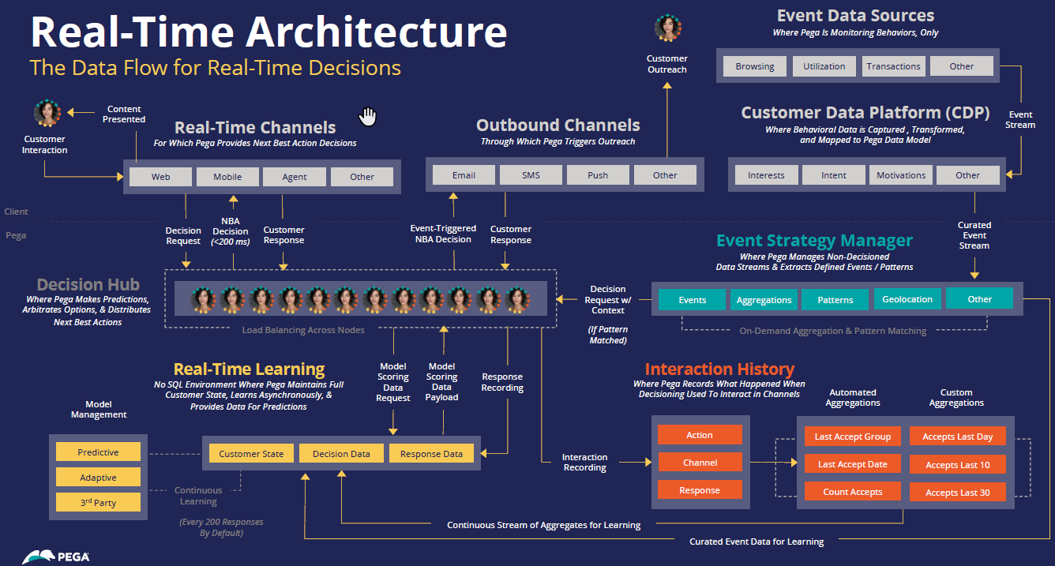

Slide 20
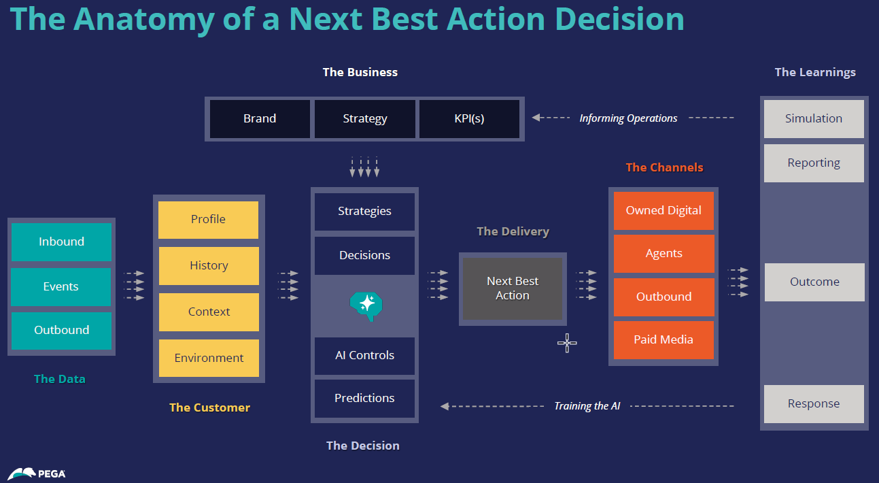

Slide 21
CVSHealth Opportunity/NBA management framework enabled by RTIM (future vision)
Capability:
New:
Modified:
Existing:
Future:
Integration:
1
2
3
Opportunity Targeting
Opportunity aggregation & coordination
Omni-channel delivery
RTIM???
Digital channels
Care Engine Targeting
Retail digital
Health Cloud
Aetna Health
PBM
Digital
SMS
Rules-based decision engine
All targeted customer communication Opportunities will be identified, aggregated, prioritized and coordinated by the enterprise customer RTIM capability.
All CVSH customer engagement channels will be centrally managed in real-time, resulting in coordinated team-work across channels and improved customer experience.
Enterprise business governance model across CVSH targeting systems will streamline targeted communications.
Disposition/feedback will be sent to the source systems in near real-time, to enable re-targeting.
Targeted Opportunities as well as near real-time delivery information will be published to the data platform, for consumption by Analytics, C360 etc.
Journey orchestration
Email
Inbound IVR
Intrado IVR & SMS
Analytics NBA
Targeting
Predictive, adaptive models
Retail channels
Feedback
Campaign management
RxConnect channels
Minute Clinic Epic
HealthHUB
POS
RPCC
De-duplication, de-collision
RPh Panels
PCC
Instore counsel
RPh AI
Retail
Targeting
Prioritization, bundling
Channel identification
HCB channels
Business governance
Real-time channel orchestration
Med compass
ATV
CEC
GPS
SFMC
HCB
Targeting
Epic CM
Disposition tracking
Thresholding, throttling
PBM channels
PBM
Targeting
NSA workflow
eClinical
Coram Epic
Outbound call center
RxAd call center
Transform care
Channel team-work
Specialty call center
Non-CVS pharmacies
Polaris
Identity resolution
Feedback
Marketing
Targeting
Preferences and consent verification
Marketing channels
Content & talk tracks
Retail marketing
HCB marketing
PBM marketing
….
….
Channel msg. customization
Data publish
Data publish
Enterprise Data platform

Slide 22
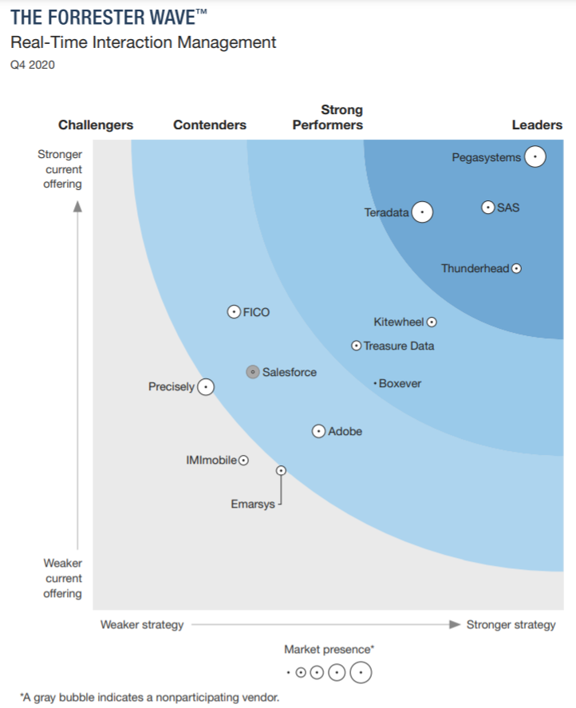

HealthHUB GiC EHP architecture powered by the HEE engine
HEE framework for Enterprise Health Plan (EHP) clients: New market-differentiating programs and campaigns configured by business ops from inception to pilot testing to full launch and revenue generation, all within days/weeks via an agile, nimble and flexible framework. Single and seamless digital self-service experience for EHP clients that use HealthHUB GiC, Retail CPCO, Retail NBA and Retail Htag programs. Member GiC identification could be either pre-identified by the client, or by HEE using the robust and advanced market leader vendor engine, Teradata CIM. Targeting, segmentation, campaign management and opportunity generation done by HEE, and Retail channel orchestration by ROCM.
Refer to:
Teradata CIM
Teradata CIM Omnichannel
eCCA Client
Digital Self-service
Health Engagement Engine (HEE)
SAP
Eligibility data
Pre-identified GiC
Business Configurable Admin UI
……
Client Billing
Client & program setup
(HEE UI)
Clinical rules & predictive analytics
Targeting & Campaign management
Opportunity generation
PBM Channel orchestration (EOMS)
……
Download data ingest templates tailored to campaign , Enroll members into program and campaign(s)
PBM channels
Instantly available
……
……
Eligibility data
……
New programs, new campaigns, new templates configured by business ops team within days and instantly made available to eCCA
EDP
EDW client self-service
RxP, RxDW
ROCM
CET
EHP B2B
PCC
New client reporting
Existing self-service client reporting
Targeting, Opportunity generation
Retail Channel orchestration, decollision
Retail channels
B2C
……
Incremental work as part of enterprise initiative, not immediately needed to launch HUB GiC EHP
……
……
Aetna B2B
Enterprise framework for Aetna clients: Callout bubbles describe limitations/uplift to support EHP clients.
Enterprise framework does not support EHP clients currently, evolving in maturity, involves manual steps, takes longer time to market new programs and campaigns.
Enterprise framework does not offer client self-service enrollment into campaigns nor client self-service reporting.
Enterprise framework would allow the clients to enroll members into a program via manual process but there is no flexibility to enroll into campaigns w/o significant manual coordination between ops team and client.
EHP clients that are in the pipeline for HealthHUB GiC are all existing Retail Pharmacy clients that are using the HEE framework for CPCO and Htag. Decoupling HealthHUB GiC onto a different framework would cause fragmented experience for the clients for enrollment and client reporting.
Significant uplift required to support HealthHUB GiC for EHP clients, w/o incremental value and ROI.
The earliest date of availability is 1/1/22 whereas business needs a solution by May 2021 with clients in the immediate pipeline to leverage for COVID vaccination campaign.
EDI on EDP
AHM Admin Suite
Care Engine
A&BC
CPL
Eligibility data
SFTP
Claims data
Data ingest
Client & program setup, eligibility data
Clinical rules & predictive analytics
Opportunity generation
Campaign management
Loss of client self-service
New instance for non-native
Manual billing, manual reconciliation
Incremental
Program level enrollment only. No campaign level enrollment
Significant work to decouple CE
Incremental build on GCP
EDP data enablement
Loss of configurable campaigns
Manual operations support
Note: Disposition data traverses back in the opposite direction of opportunity flow

